Slide 1
Anomalies in Relational Model
Anomalies

Slide 2
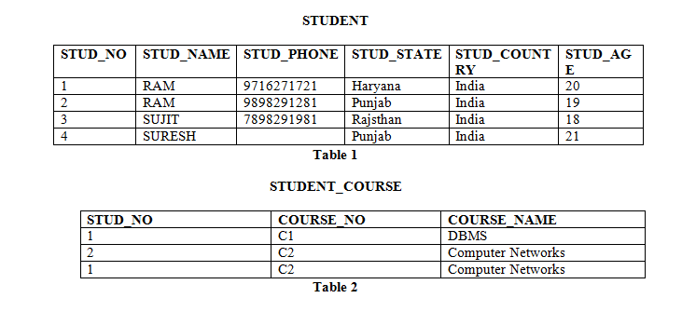
Different Types of Keys in Relational Model
Insertion anomaly: If a tuple is inserted in referencing relation and referencing attribute value is not present in referenced attribute, it will not allow inserting in referencing relation. For Example, If we try to insert a record in STUDENT_COURSE with STUD_NO =7, it will not allow.

Slide 3
Different Types of Keys in Relational Model
Deletion and Updation anomaly: If a tuple is deleted or updated from referenced relation and referenced attribute value is used by referencing attribute in referencing relation, it will not allow deleting the tuple from referenced relation. For Example, If we try to delete a record from STUDENT with STUD_NO =1, it will not allow. To avoid this, following can be used in query:
ON DELETE/UPDATE SET NULL: If a tuple is deleted or updated from referenced relation and referenced attribute value is used by referencing attribute in referencing relation, it will delete/update the tuple from referenced relation and set the value of referencing attribute to NULL.
ON DELETE/UPDATE CASCADE: If a tuple is deleted or updated from referenced relation and referenced attribute value is used by referencing attribute in referencing relation, it will delete/update the tuple from referenced relation and referencing relation as well.

